Slide 1



GITAM
INTEL UNNATI TRAINING
SUMMER INTERNSHIP - 2024

Slide 2
TABLE OF CONTENT
Problem Statement
Unique Idea
Features Offered
Process Flow
Architecture Diagram
Technologies Used
Team members and Contribution
Conclusion

Slide 3
PROBLEM STATEMENT
Cryptography Simulation with mbedTLS/OpenSSL Library Usage and User Interaction”.

Slide 4
UNIQUE IDEA BRIEF (SOLUTION)
The project aims to create an interactive cryptography simulation platform that leverages mbedTLS or OpenSSL libraries. Users will be able to establish a secure connection between the server and the client. 3rd party cannot access the conversation between the server and the client. The conversation can only be decrypted/analysed by using the respective key.

Slide 5


FEATURES OFFERED
Educational Modules: Step-by-step tutorials and explanations for various cryptographic concepts and algorithms.
Real-Time Simulations: Live demonstrations of cryptographic processes such as encryption/decryption, digital signing, and verification.
Multiple Algorithms: Support for various cryptographic algorithms including AES, RSA, DH, and more.

Slide 6
Security Analysis: Tools to visualize and understand the security implications of different cryptographic choices.
Cross-Platform Compatibility: Available on multiple operating systems including Windows, macOS, and Linux.
Integration with mbedTLS/OpenSSL: Seamless integration with two leading cryptographic libraries, mbedTLS and OpenSSL, providing robust and well-tested implementations of cryptographic functions.

Slide 7

PROCESS FLOW
1. Installation of OpenSSL library, Wireshark, and their setup
2. Generation of certificates linking each other
3. Extract the zip file provided by the mentor and open it in Visual Studio.
4. Initialization of OpenSSL libraries files and their paths to Visual Studio.
5. Coding CPP files and testpassing them, which leads to creation of a chat bot in command prompt.
6. Tracking the chat using wireshark in the encrypted format.
7. Decrypting the text using the private key generated at the time of tracking.
8. The main motto of the both exercises is creating a secure traffic between client and server.

Slide 8
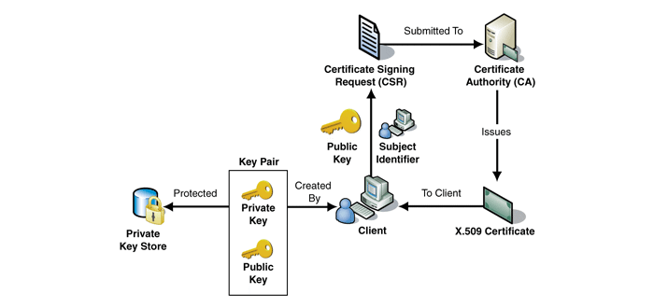
ARCHITECTURE DIAGRAM - EXERCISE 1

Slide 9
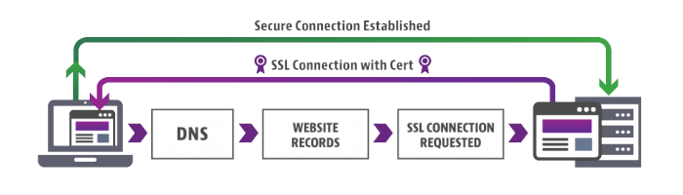
ARCHITECTURE DIAGRAM - EXERCISE 2

Slide 10
TECHNOLOGIES USED
Cryptographic Libraries:
OpenSSL
Programming Languages:
C++
Softwares:
Wireshark
Visual Studio 2019
System Resources:
Command Prompt

Slide 11
TEAM MEMBERS AND CONTRIBUTION
B. Thanuja - Certificate Generation, Resources searcher
J. Dheeraj Lakshman - Library Installation & Coding, Presentation
K. Koushik - Library Installation, Coding & Presentation, Documentation

Slide 12
CONCLUSION
Using OpenSSL or mbedTLS libraries, the interactive cryptography simulation platform provides a reliable and workable way to create secure connections between a client and a server. This guarantees that all interactions are encrypted, shielded from prying eyes, and can only be decrypted with the appropriate keys. This platform offers users priceless practical experience and profound insights into the critical role that cryptography plays in protecting digital communications, based on our extensive knowledge in cryptographic implementations and secure communication protocols.

Slide 13
THANK YOU

